Slide 1


EAGE HPC Workshop Hackathon 2024
Embeddings for Pre-Stack Seismic Data
11 September, 2024

Slide 2


Meet your facilitators – Oleg and Nick
Oleg Ovcharenko (NVIDIA)
Oleg is a Senior Solutions Architect at NVIDIA focusing on Generative AI applications and HPC in energy. He received his PhD in Earth Science from KAUST where he was exploring data-driven methods for the initialization of full-waveform inversion. Oleg is broadly interested in HPC and deep learning applications in geophysics.
Nick Luiken (NVIDIA)
Nick Luiken is a Deep Learning Solutions Architect for the energy sector at NVIDIA. He is specialized in inverse problems, applications of deep learning in inverse problems and HPC. He holds a PhD in Applied Mathematics from Utrecht University and was a postdoctoral researcher at KAUST before joining NVIDIA.

Slide 3
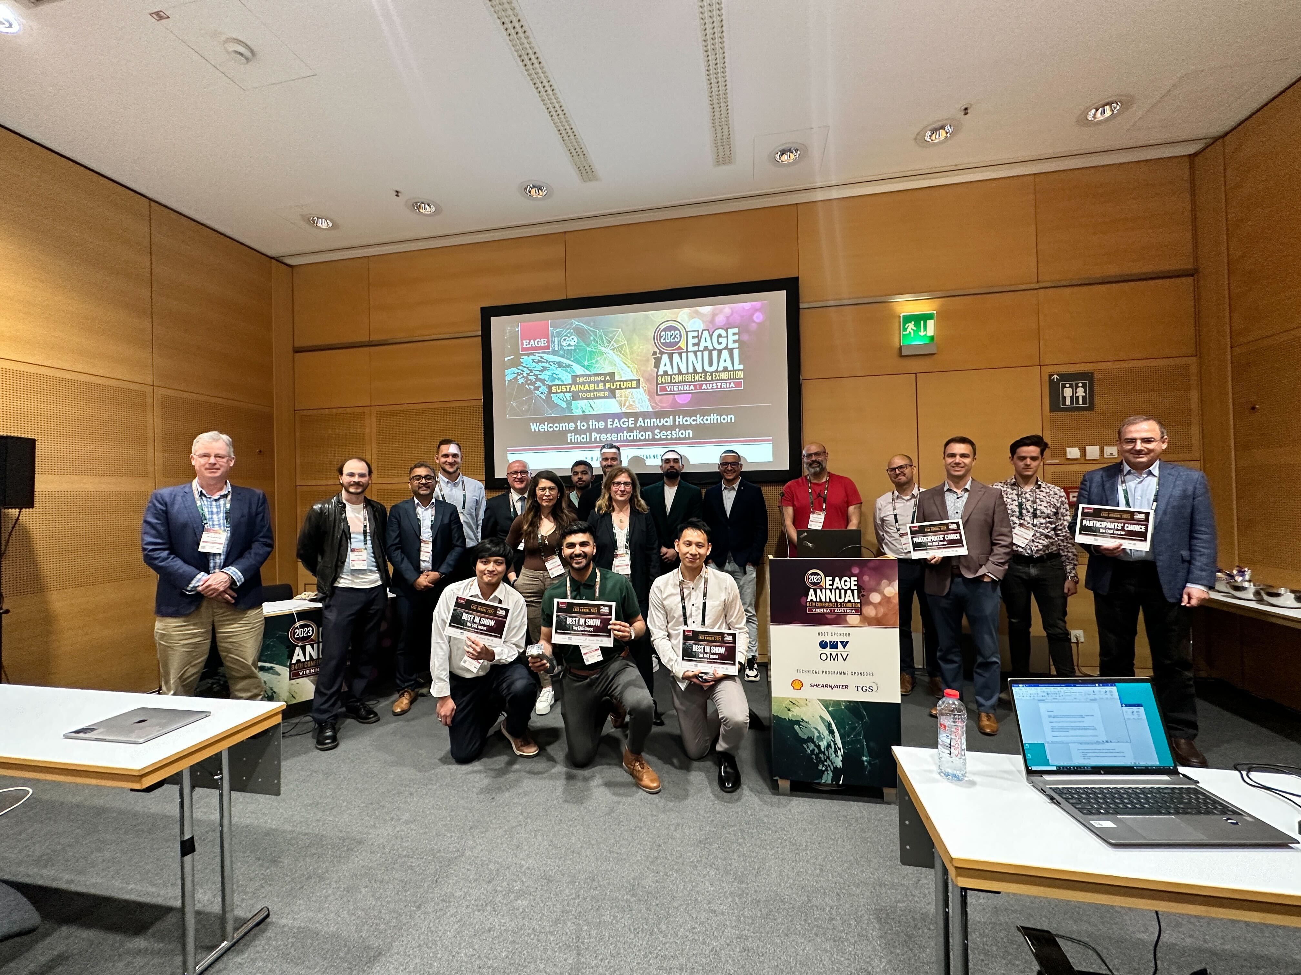
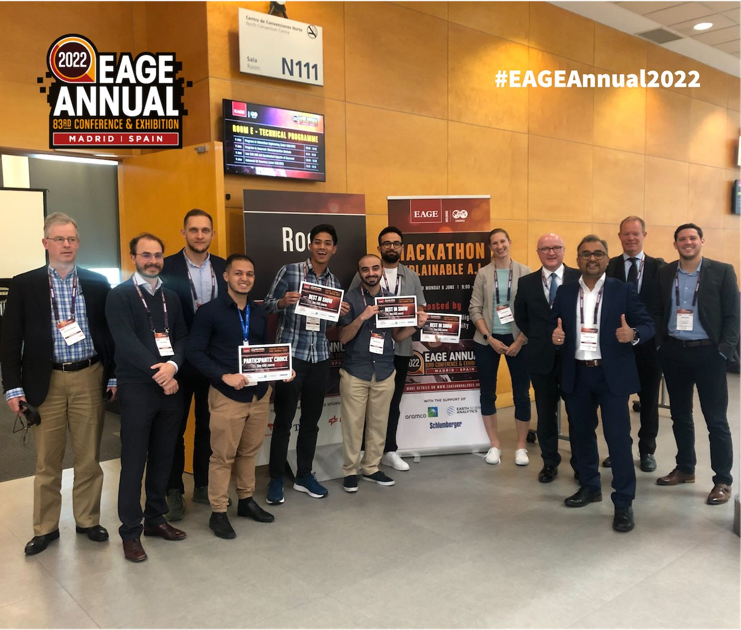
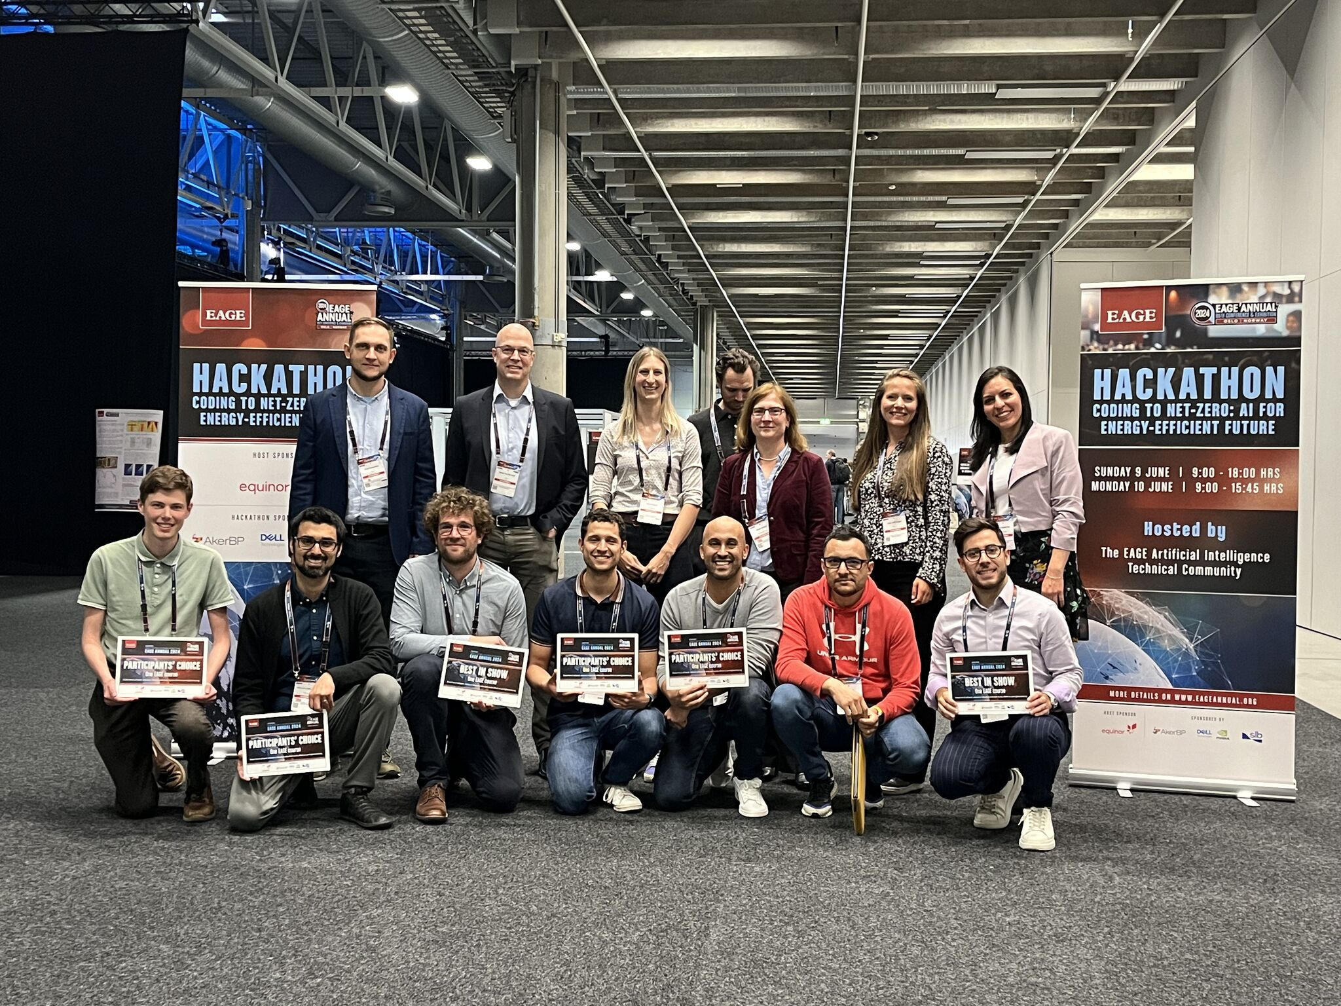
Hackathon History at the EAGE
https://github.com/EAGE-Annual-Hackathon

Slide 4
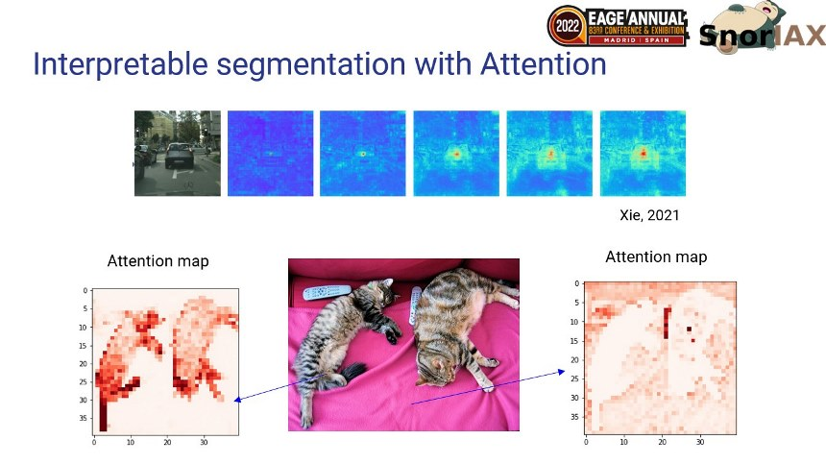
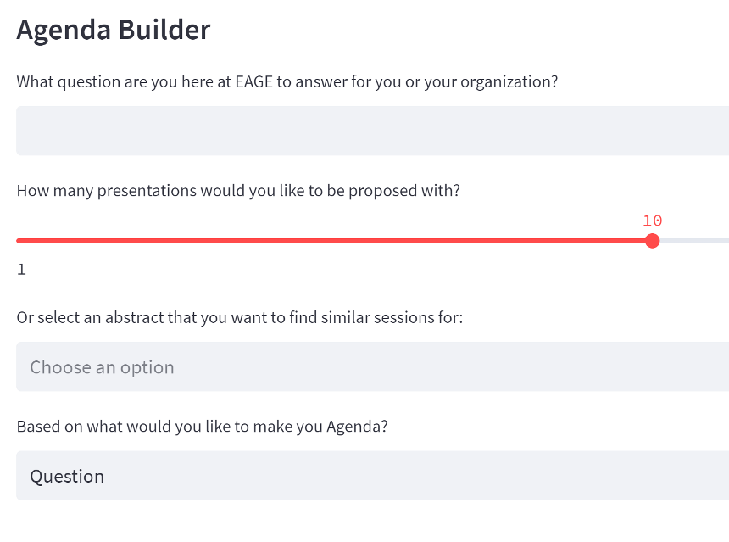
Hackathon History at the EAGE
Madrid (2022): Explainable AI
Vienna (2023): Natural Language Processing
Oslo (2024):
Coding to net-zero

Slide 5
Agenda
☕👩‍💻☕🥪👩‍💻☕☕☕🥪🥵🙌🙋‍♀️🤩
Day 1: Wednesday, Sep 11
Day 2: Sunday, Sep 15
9:00 - 9:30 – Welcome 9:30 - 10:30 – Introduction and problem 10:30 – 11:00 – Compute resources
11:30 - 12:00 - Starter Kit
09:00am - 09:30am: Meet & Greet
09:30am - 12:00pm: Welcome Note, Projects and Teams Overview
12:00pm - 13:00pm: Lunch
13:00pm - 16:00pm: Teams work on their approach & preparing presentations
16:00pm - 17:00pm: Teams to present their findings and presentations
19:00pm - 21:00pm: Ice Breaker sponsored by Shell: Winner Announcement & Awards
Winning presentations will present at the Energy Transition Theatre: Tuesday 11th 14:30

Slide 6
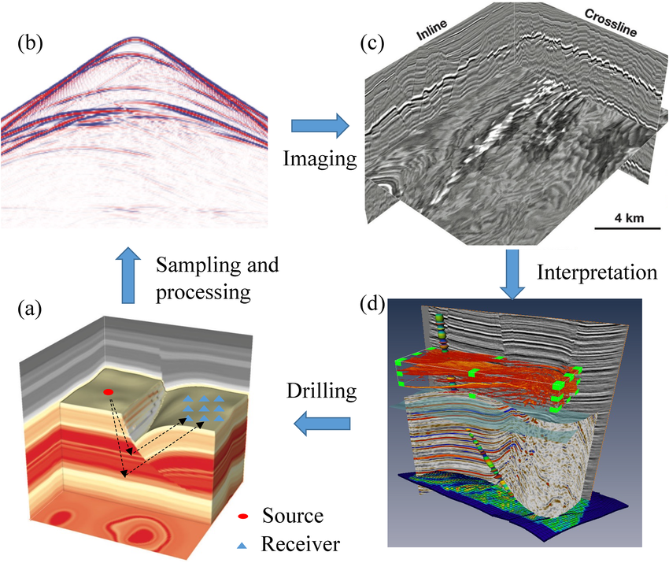
Exploration geophyscis

Slide 7
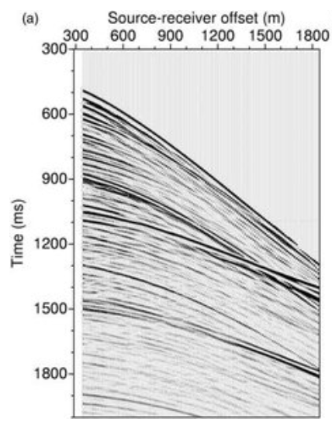
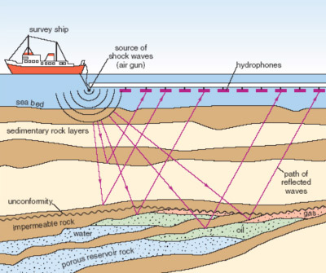
Seismic data - marine
https://www.researchgate.net/publication/248805282_Reflection_seismic_waveform_tomography/figures?lo=1

Slide 8
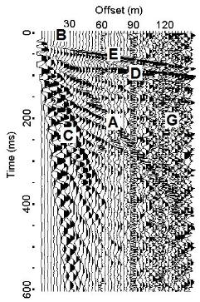
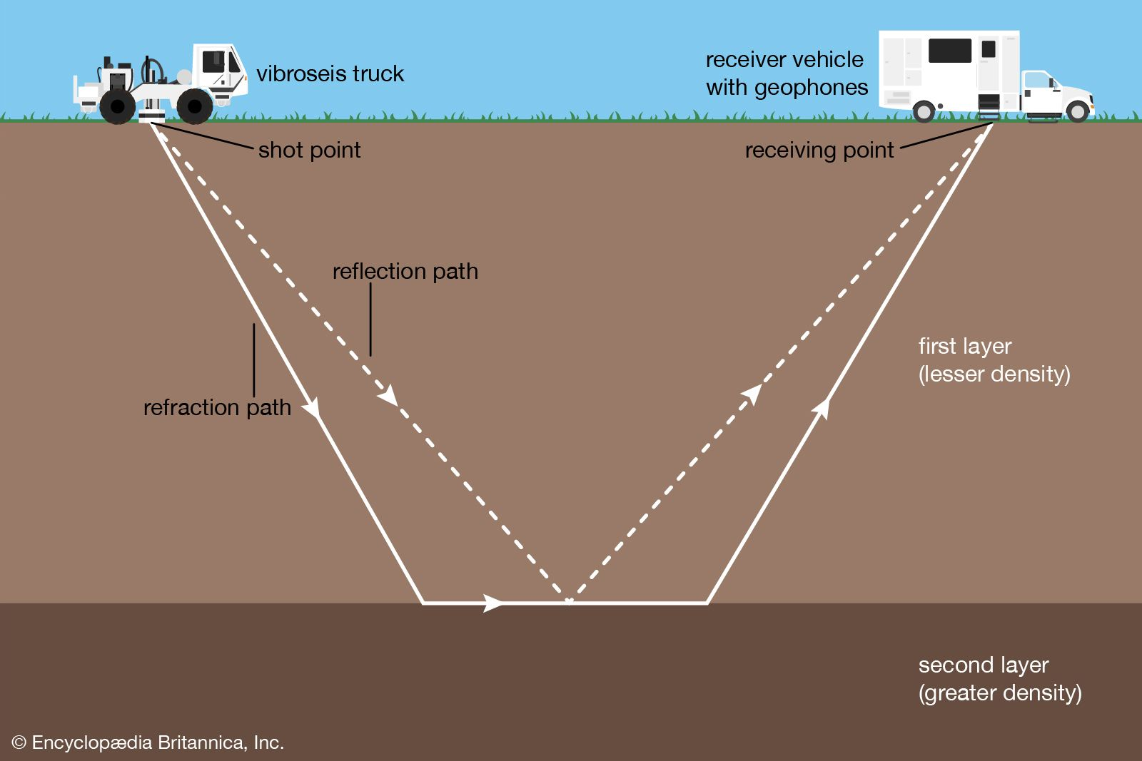
Seismic data - land
https://www.parkseismic.com/whatisseismicsurvey/

Slide 9
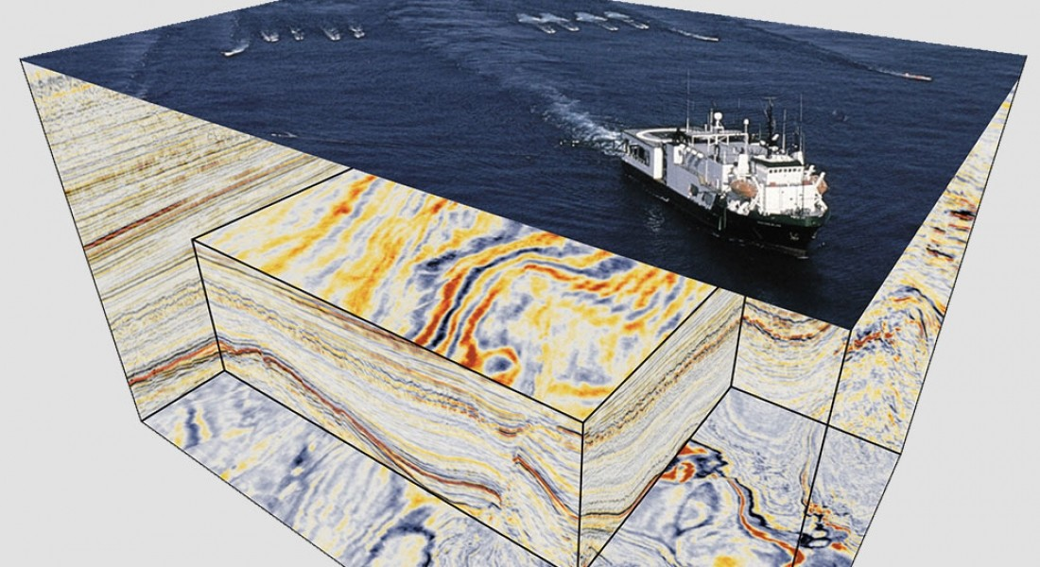
https://www.linkedin.com/pulse/exploration-seismic-data-acquisition-neal-s-turluck/

Slide 10
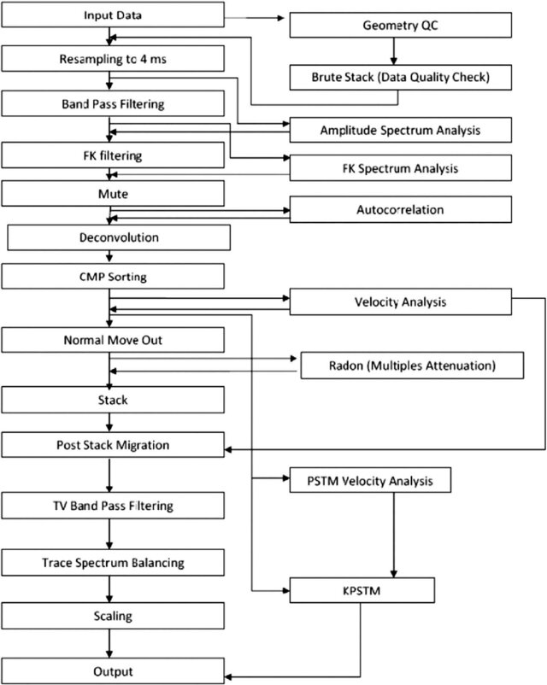
Need to do
Manipulations on PB of data
Checkpointing during inversion
Similarity search
Etc
https://www.researchgate.net/publication/342247689_Improvement_of_Gulf_of_Suez_subsurface_image_under_the_salt_layers_through_re-processing_of_seismic_data-a_case_study_Improvement_of_Gulf_of_Suez_subsurface_image_under_the_salt_layers_through_re-proc/figures?lo=1

Slide 11
Problem: Large amounts of heavy data
- Can we compress the data?
- Yes, we can. Methods like BitComp help with it.
Is the problem solved?
No. Seismic data is large and redundant. Deep learning showed the promise of embeddings in the latent space but it is not explored yet.
Is it only about compression?
No.
If we have an efficient method to preserve meaningful info with fewer bytes we will kill many birds with one stone

Slide 12
Solution: Explore embeddings for seismic data
> Compress / decompress loselessly
> What value we could extract from deep embeddings?
Land and marine cluster separately
Synthetic and real cluster separately
Can you ask data where the first arrival was?
Analogies with video analytics?

Slide 13
Data and starting notebook
You are encouraged to use your own ready-to-use datasets

Slide 14
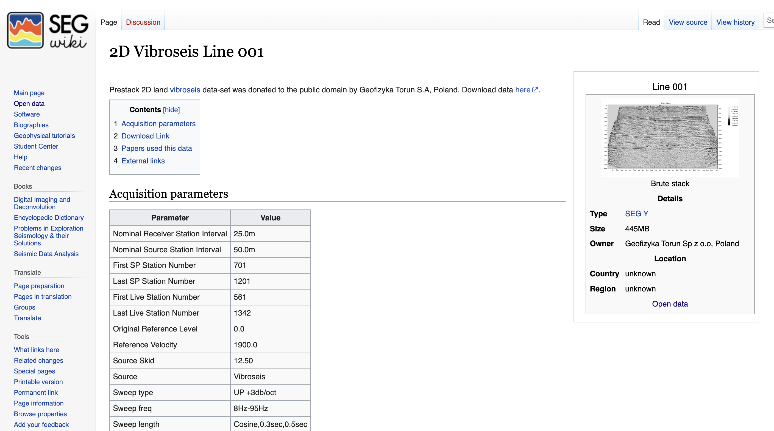
Land data with groundroll
https://wiki.seg.org/wiki/2D_Vibroseis_Line_001

Slide 15
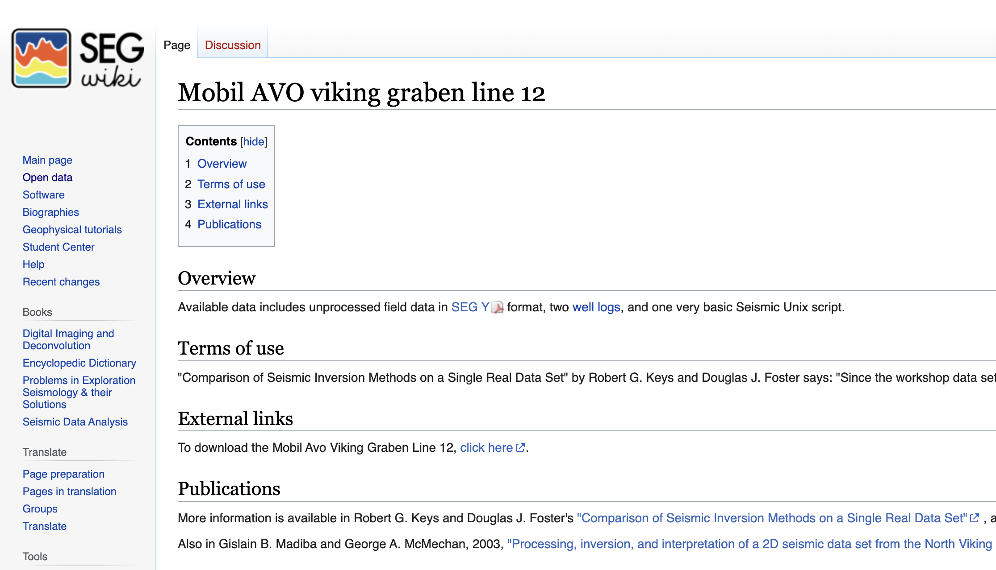
Marine streamer data
https://wiki.seg.org/wiki/Mobil_AVO_viking_graben_line_12

Slide 16
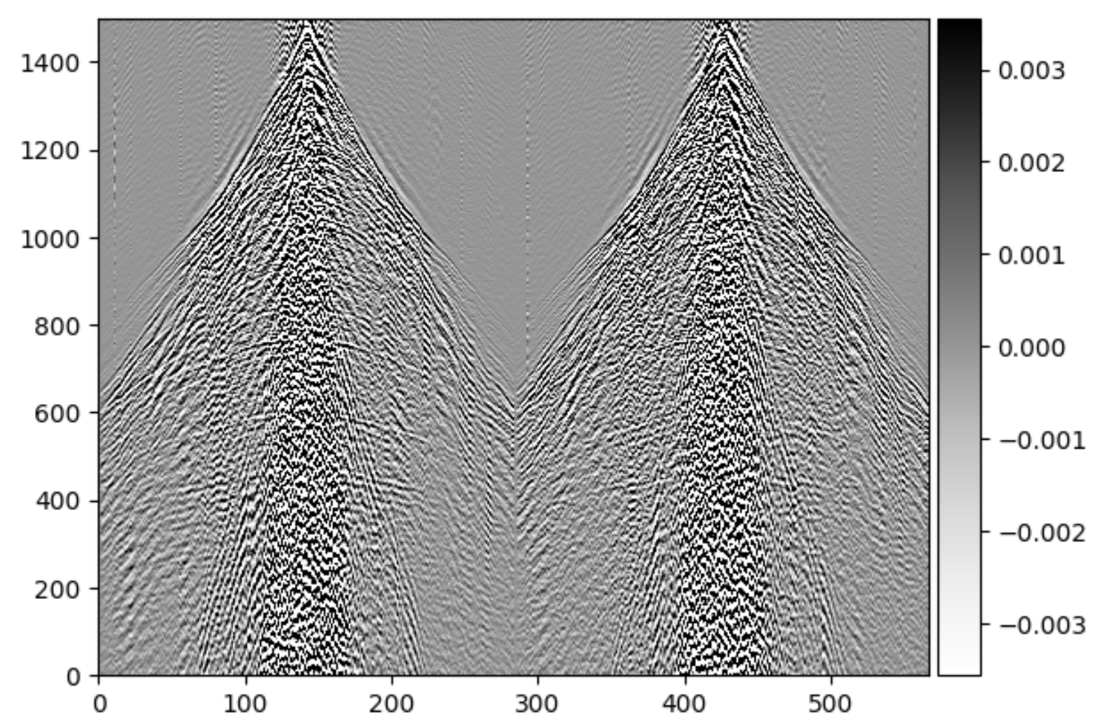
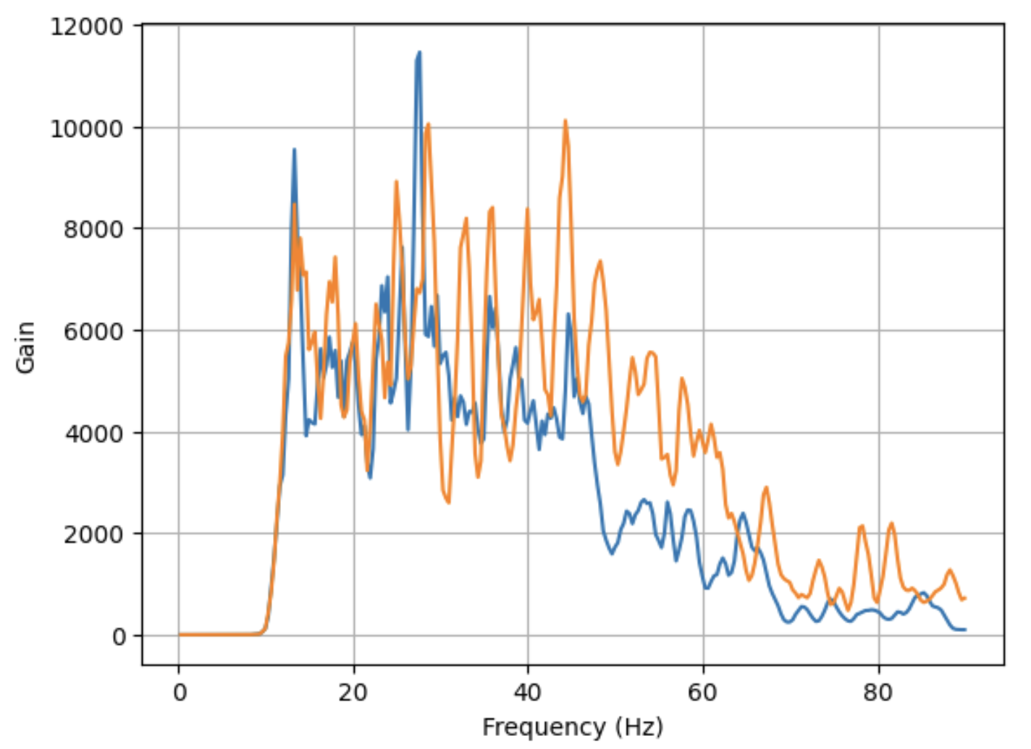
Land data with groundroll
https://wiki.seg.org/wiki/2D_Vibroseis_Line_001

Slide 17
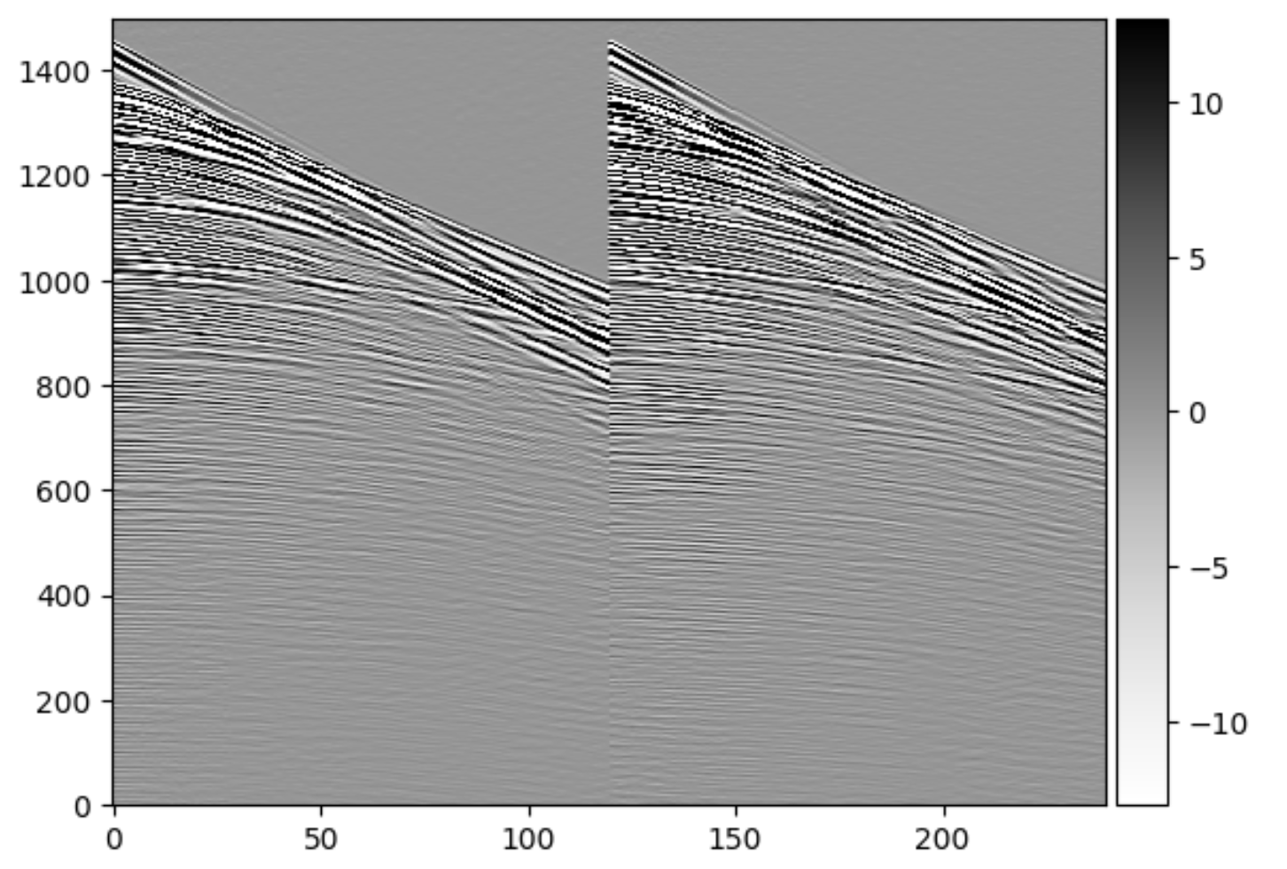
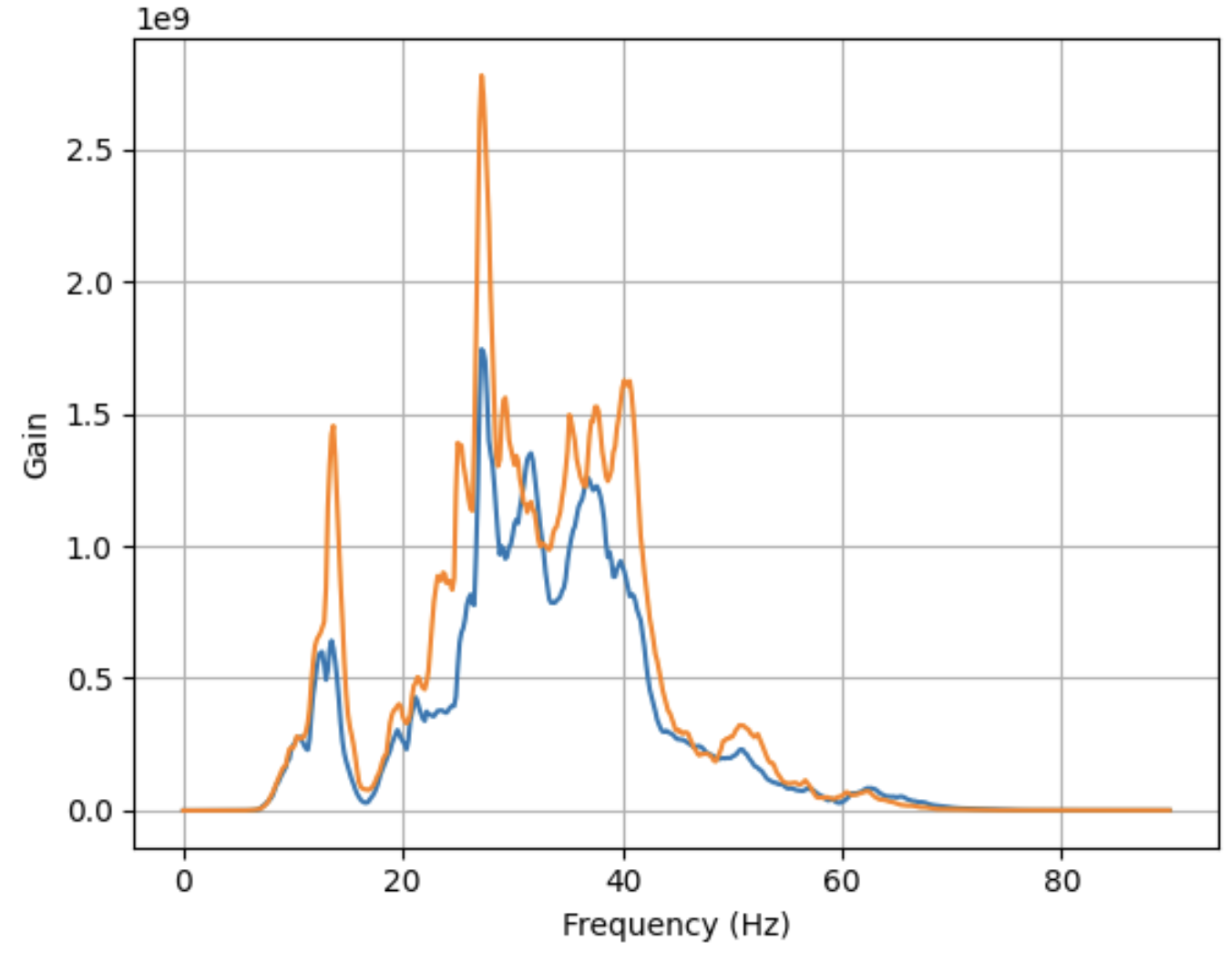
Marine streamer data
https://wiki.seg.org/wiki/Mobil_AVO_viking_graben_line_12

Slide 18
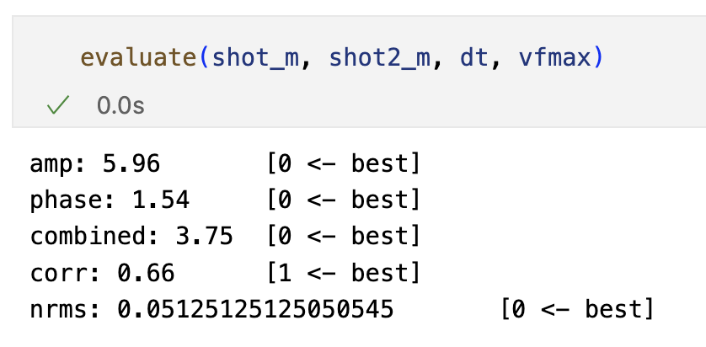
Evaluation: how to compare two shots?
https://wiki.seg.org/wiki/Mobil_AVO_viking_graben_line_12

Slide 19
Keep last 20 shots from each dataset for validation and testing [N/10/10]

Slide 20
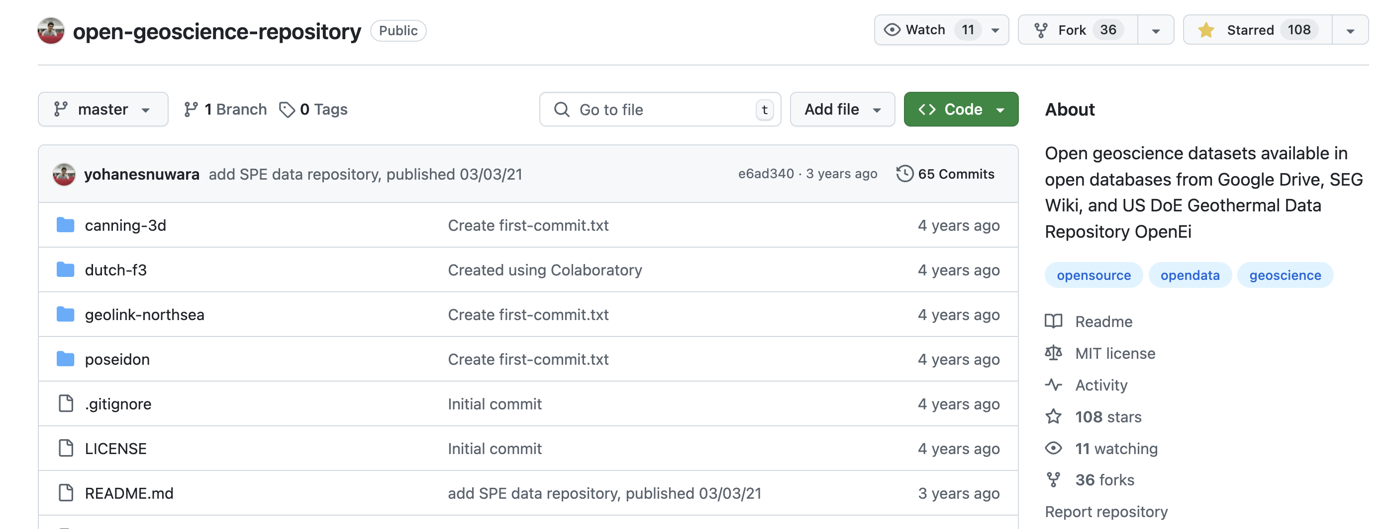
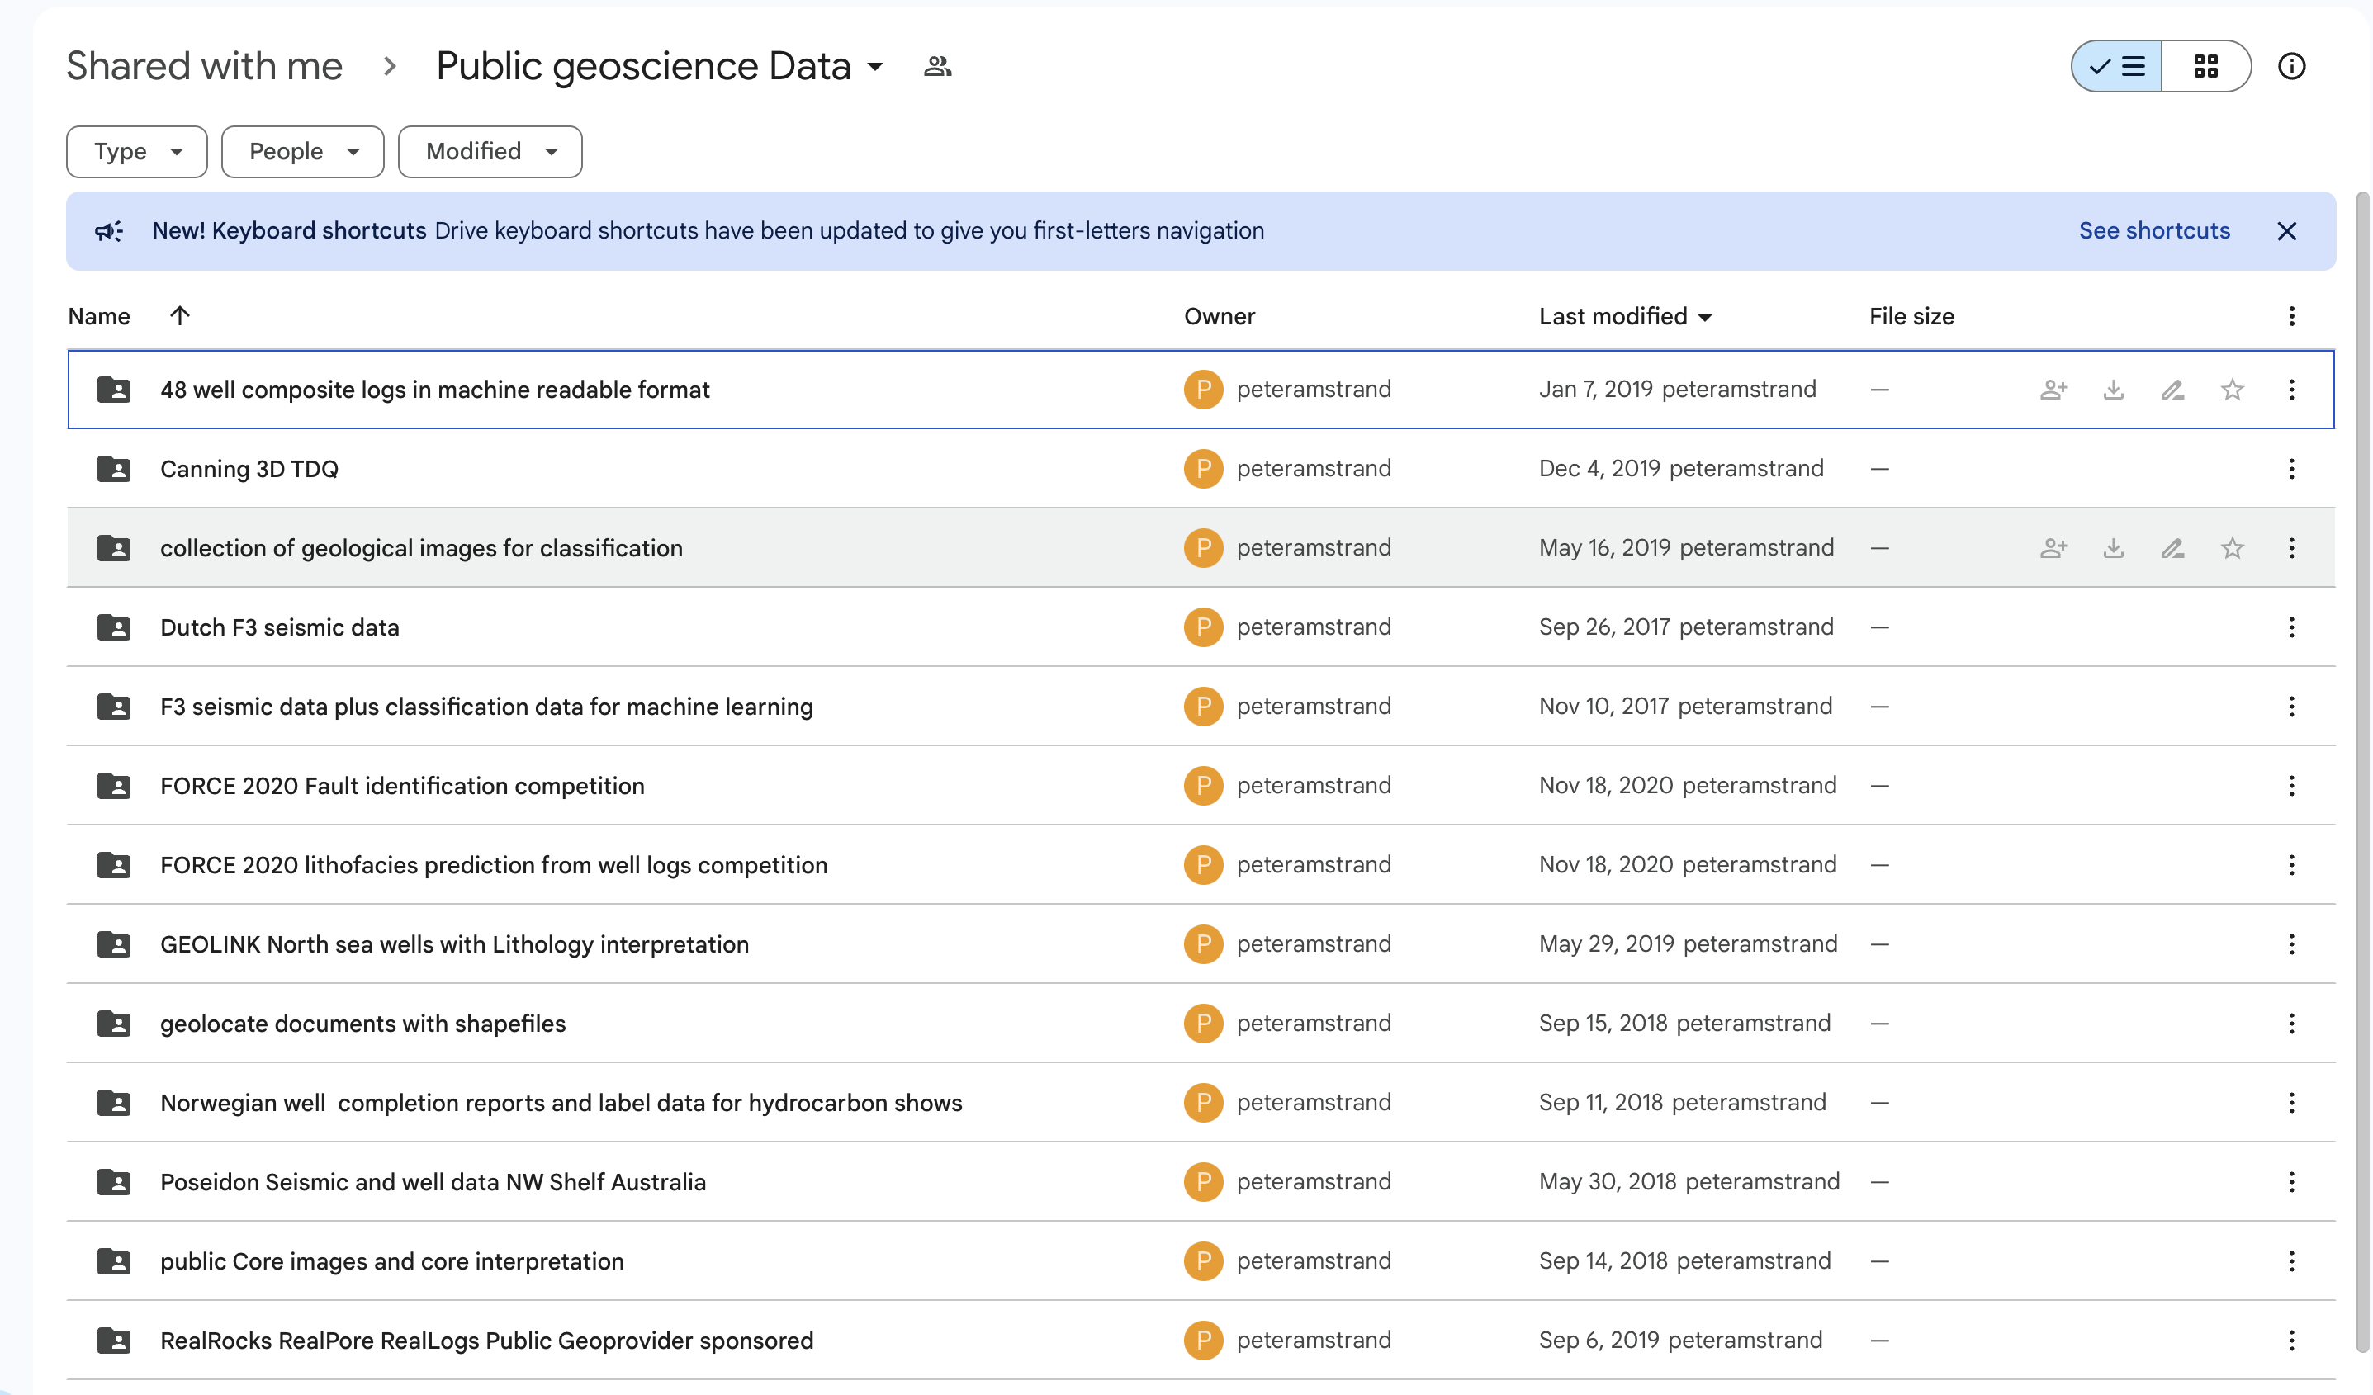
Open seismic datasets
https://github.com/yohanesnuwara/open-geoscience-repository/tree/master

Slide 21
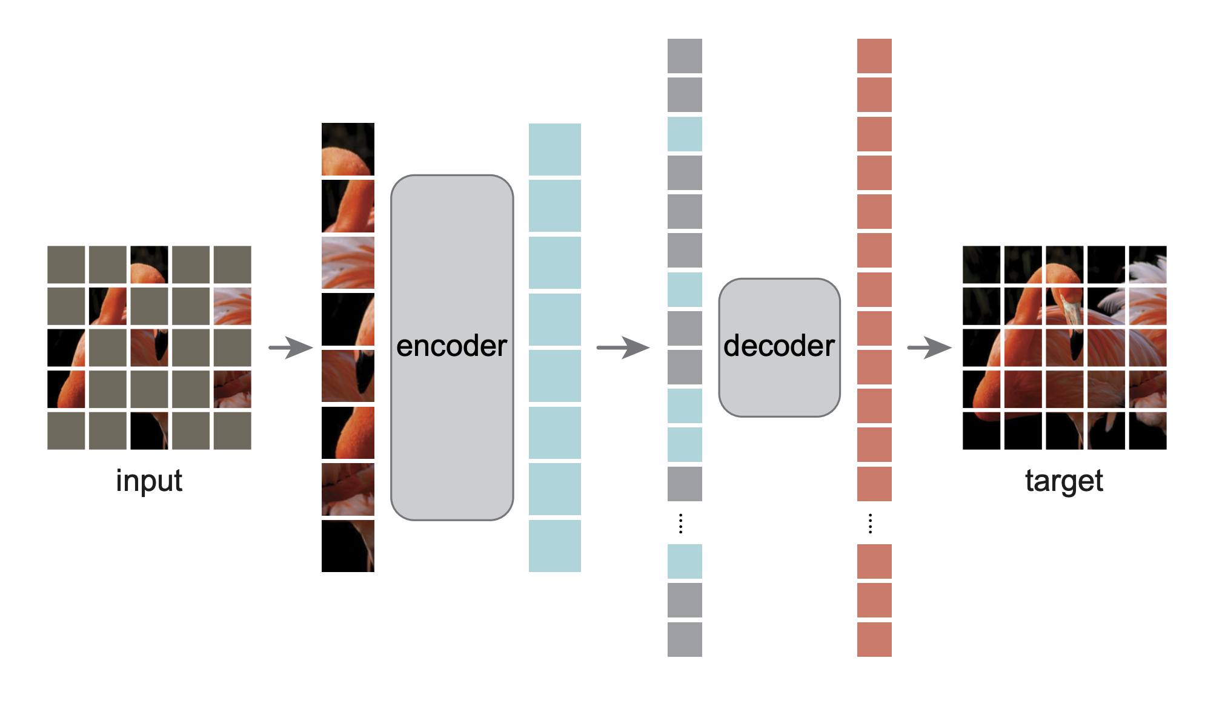
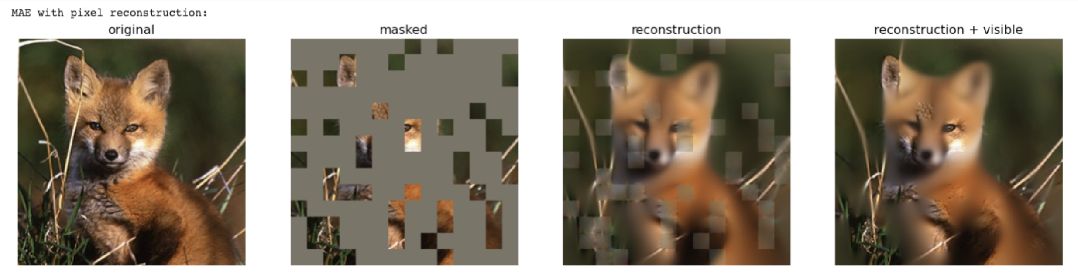
Masked Autoencoders with Vision Transformer backbone
https://github.com/facebookresearch/mae?tab=readme-ov-file

Slide 22


Award!
Audience Choice – Chosen by you!
There is an award for you to grab.
The winner team will be announced during the Ice-Breaker reception!
Best in Show – chosen by a panel of judges

Slide 23
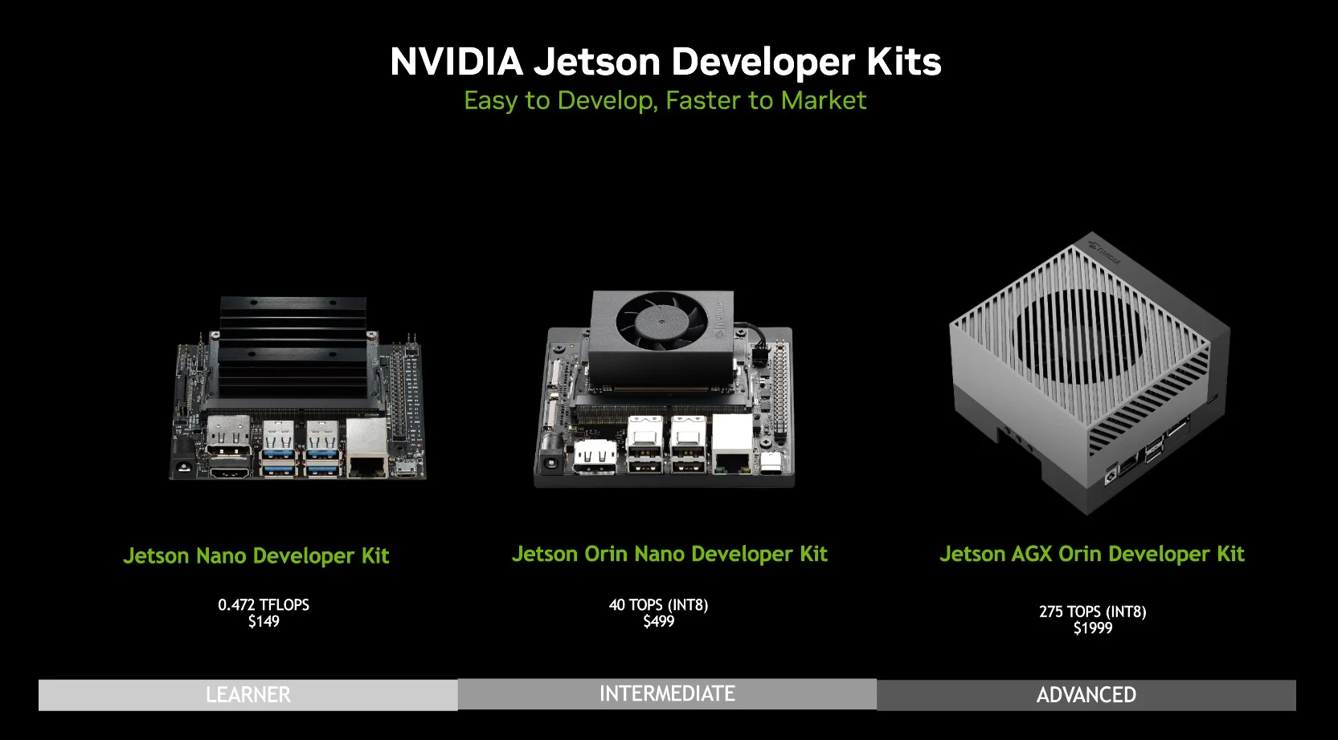

Slide 24
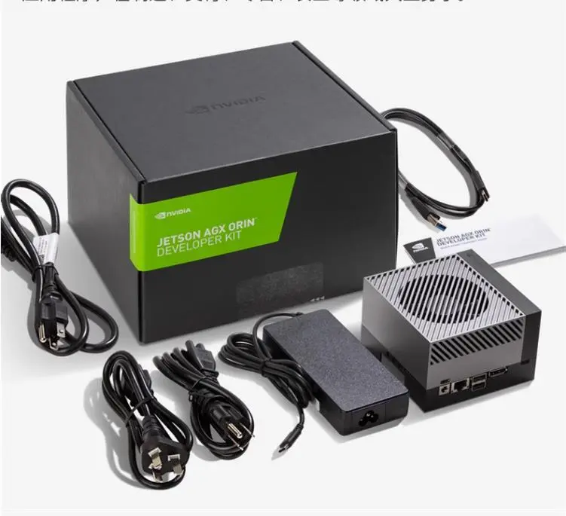
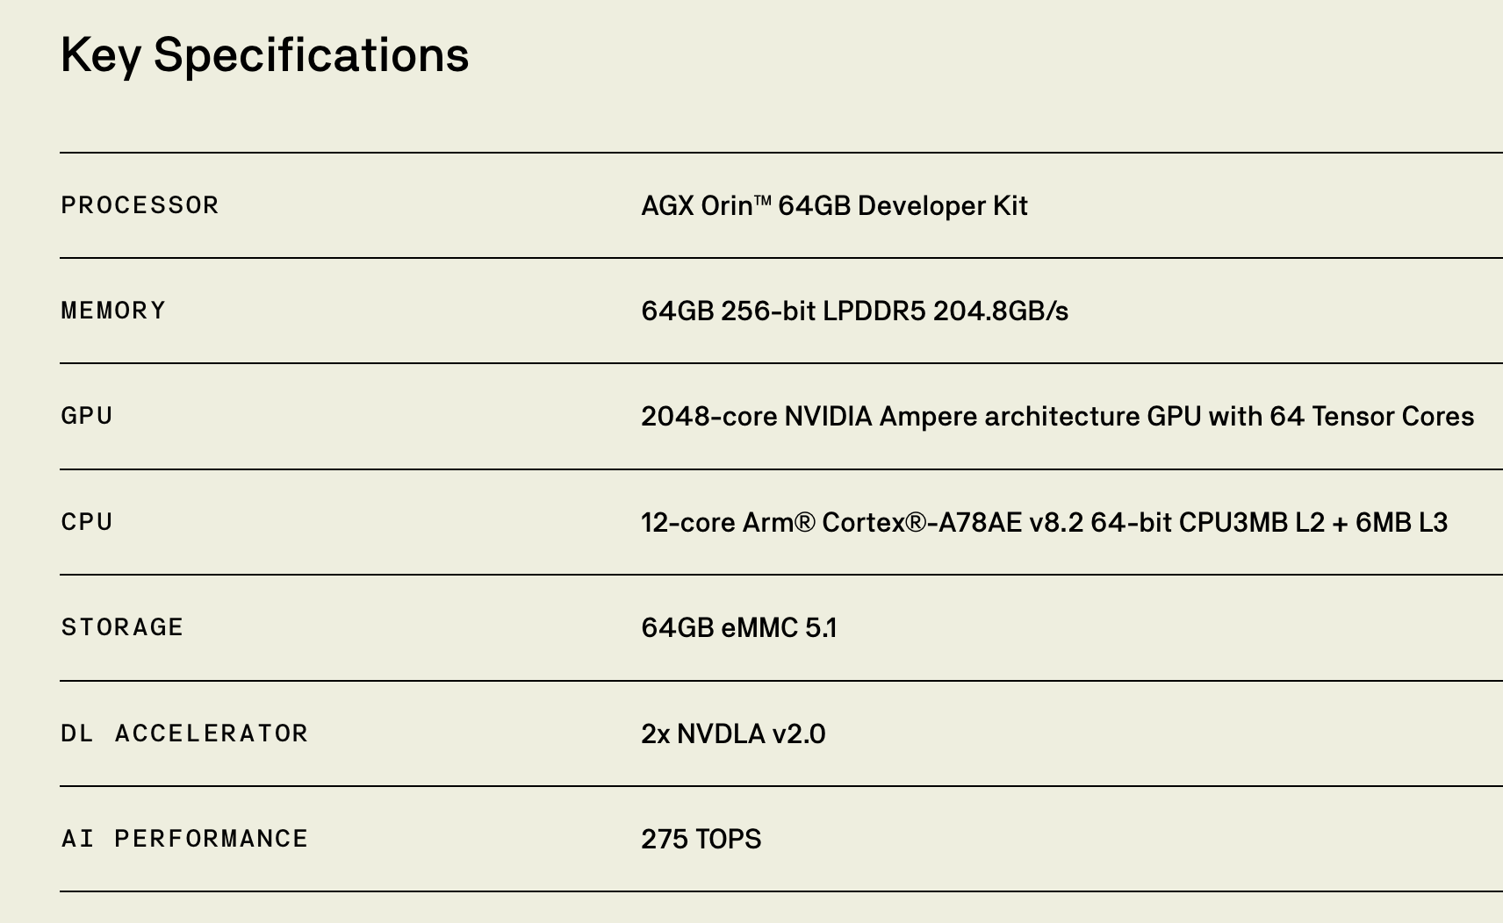
Award!

Slide 25
Github expectations
All teams are expected to upload their code and presentations to a Github Repo within the EAGE-Annual-Hackathon team.
You will find these slides, instructions, agenda in the EAGE-2024-Hackathon-Instructions Repo.
If you need any help working with Github – just ask a facilitator!
Link will be shared later
https://github.com/EAGE-Annual-Hackathon/EAGE-HPC-Workshop-Hackathon-2024-Instructions

Slide 26
Some Hackathon Tips
Take screenshots as you go along – this will save a lot of time when you come to preparing the final presentation
A little planning goes a long way – post its to organize your work or making a list can help keep focus. Github Issues is a way to digitally keep track as well.
By the end of the day today you should at a minimum have settled on a specific case, sketched out a plan, and have started some work.
Ensure you are addressing the theme of the hackathon!

Slide 27
Some General Recommendations
Be mindful towards others and yourself.
Ask for help
Interact with other teams
Try to close the loop early. Data>Baseline>Test>Measure>Learn
One key item, is better than 100 half-baked things
Focus on things that will get your idea across
Keep it simple, s**** (KISS)
Get to know your teammates, play into your strengths
Maximize learning, over winning. Learning *is* winning.
Presentation is key and framing to the theme
Dare to go your own way: Every hackathon, project, team, and individual are unique.
Source: Accumulated Hackathon Experience

Slide 28


Reminder: Hackathons aren’t about getting a perfect solution or answer – it is about trying something new, being bold and learning along the way

Slide 29

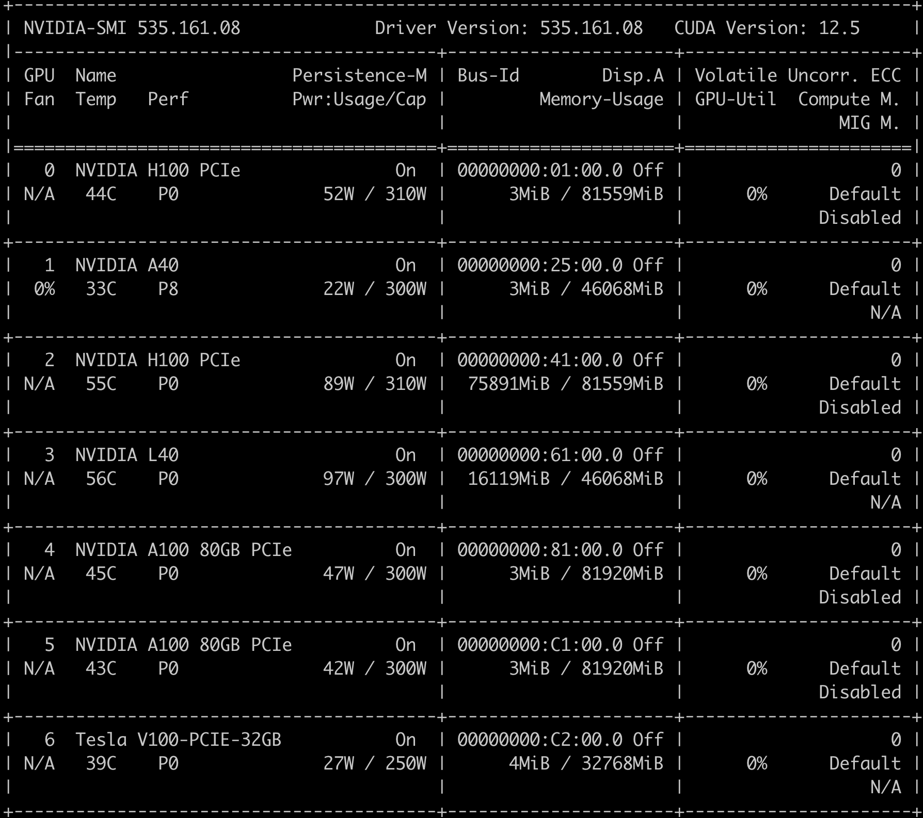
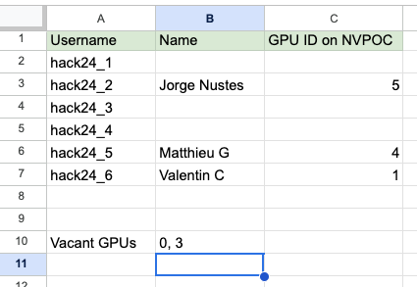
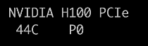
GPU resources 1/2
POC server
Connect to login node:
ssh you_login@nvpoc.ddnsfree.com
Run interactive session:
srun --gpus 1 --pty bash -i
NVIDIA Docker Container Repository
https://catalog.ngc.nvidia.com/
7 x <<GPUs>>
Select your GPU
https://docs.google.com/spreadsheets/d/1zthOg-z1wTAHymdNf6mA2cvjru8OAWflWp7Tl9vdTdk/edit#gid=0
Full details:
https://docs.google.com/document/d/1ce94uqAhiggMm9IQvgMElNZiI-T3XDTklsjPcpcv0qA/edit?usp=sharing

Slide 30
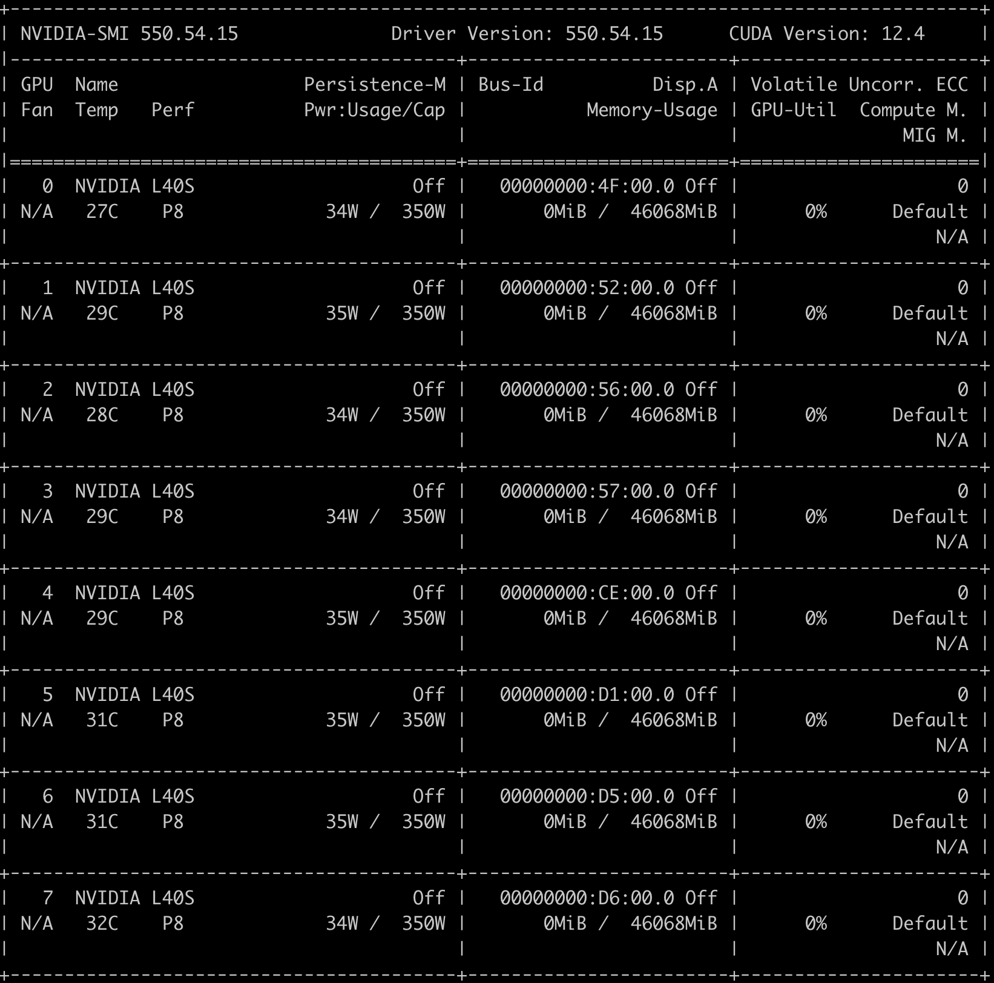
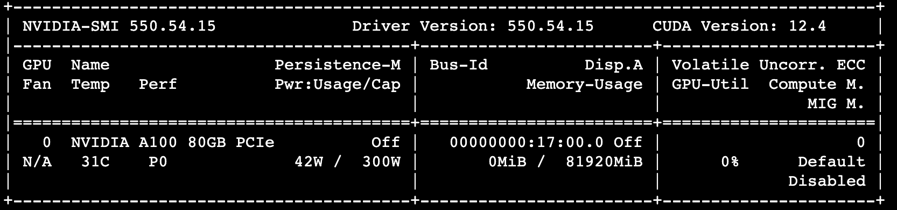
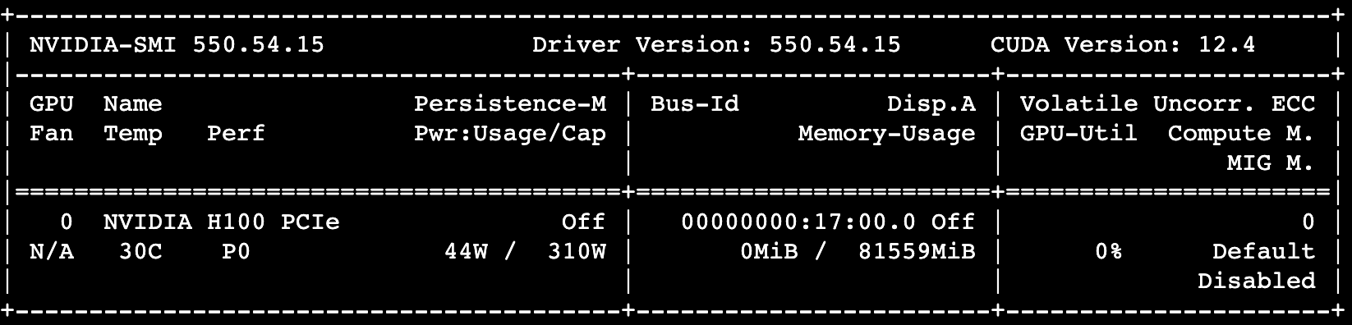
GPU resources 2/2
NVIDIA Launchpad instances
8 x L40S
4 x A40
1 x H100
Select your GPU
https://docs.google.com/spreadsheets/d/1zthOg-z1wTAHymdNf6mA2cvjru8OAWflWp7Tl9vdTdk/edit#gid=0
Notes:
ssh://nvidia@TRY-32688-gpu01:22

Slide 31

GPU resources 2/2
Select your GPU
https://docs.google.com/spreadsheets/d/1zthOg-z1wTAHymdNf6mA2cvjru8OAWflWp7Tl9vdTdk/edit#gid=0
Full details:
https://docs.google.com/document/d/1ce94uqAhiggMm9IQvgMElNZiI-T3XDTklsjPcpcv0qA/edit?usp=sharing
Notes:
ssh://nvidia@TRY-32688-gpu01:22

Slide 32
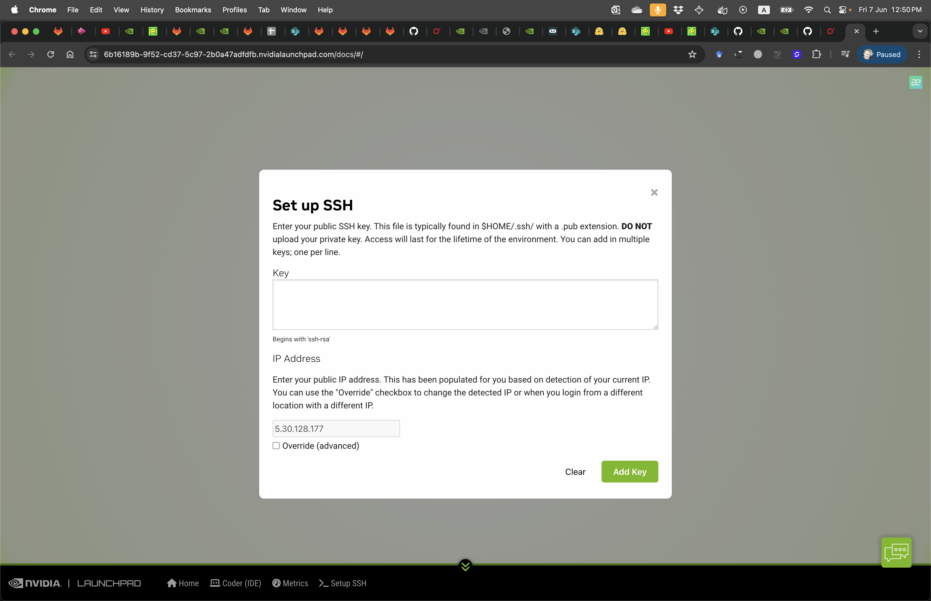

GPU resources 2/2
Notes:
ssh://nvidia@TRY-32688-gpu01:22

Slide 33
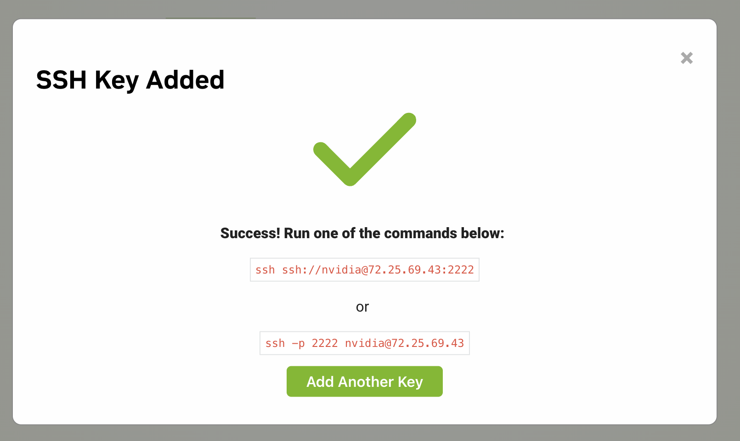
GPU resources 2/2
Notes:
ssh://nvidia@TRY-32688-gpu01:22

Slide 34
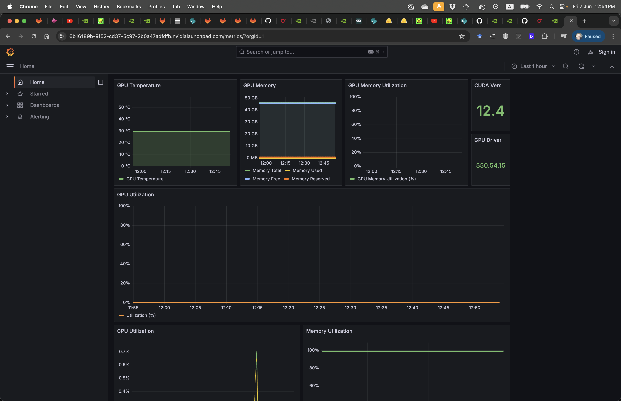
GPU resources 2/2
Notes:
ssh://nvidia@TRY-32688-gpu01:22

Slide 35
Ideas and Teams
Some Mentioned Ideas
Any other ideas?
Compare embedding methods
Explore generalization capability
Make out-of-box marine data compressor
Can you overfit the data?
Please make teams of 2 or 3

Slide 36
Day Last:
EAGE HPC Workshop Hackathon 2024
Embeddings for Pre-Stack Seismic Data
15 September, 2024

Slide 37
Meet your facilitators – Oleg and Nick
Oleg Ovcharenko (NVIDIA)
Oleg is a Senior Solutions Architect at NVIDIA focusing on Generative AI applications and HPC in energy. He received his PhD in Earth Science from KAUST where he was exploring data-driven methods for the initialization of full-waveform inversion. Oleg is broadly interested in HPC and deep learning applications in geophysics.
Nick Luiken (NVIDIA)
Nick Luiken is a Deep Learning Solutions Architect for the energy sector at NVIDIA. He is specialized in inverse problems, applications of deep learning in inverse problems and HPC. He holds a PhD in Applied Mathematics from Utrecht University and was a postdoctoral researcher at KAUST before joining NVIDIA.

Slide 38
Agenda
☕👩‍💻☕🥪👩‍💻☕☕☕🥪🥵🙌🙋‍♀️🤩
Day 1: Wednesday, Sep 11
Day 2: Sunday, Sep 15
9:00 - 9:30 – Welcome 9:30 - 10:30 – Introduction and problem 10:30 – 11:00 – Compute resources
11:30 - 12:00 - Starter Kit
09:00am - 09:30am: Meet & Greet
09:30am - 10:30pm: Welcome Note, Projects and Teams Overview
12:00pm - 13:00pm: Lunch
13:00pm - 16:00pm: Teams work on their approach & preparing presentations
16:00pm - 17:00pm: Teams to present their findings and presentations
19:00pm - 21:00pm: Ice Breaker sponsored by Shell: Winner Announcement & Awards
Winning presentations will be announced at the Ice Breaker event in Al Marsa restaurant

Slide 39
Exploration geophyscis

Slide 40
Problem: Large amounts of heavy data
- Can we compress the data?
- Yes, we can. Methods like BitComp help with it.
Is the problem solved?
No. Seismic data is large and redundant. Deep learning showed the promise of embeddings in the latent space but it is not explored yet.
Is it only about compression?
No.
If we have an efficient method to preserve meaningful info with fewer bytes we will kill many birds with one stone

Slide 41
Solution: Explore embeddings for seismic data
> Compress / decompress loselessly
> What value we could extract from deep embeddings?
Land and marine cluster separately
Synthetic and real cluster separately
Can you ask data where the first arrival was?
Analogies with video analytics?

Slide 42
Evaluation: how to compare two shots?
https://wiki.seg.org/wiki/Mobil_AVO_viking_graben_line_12

Slide 43
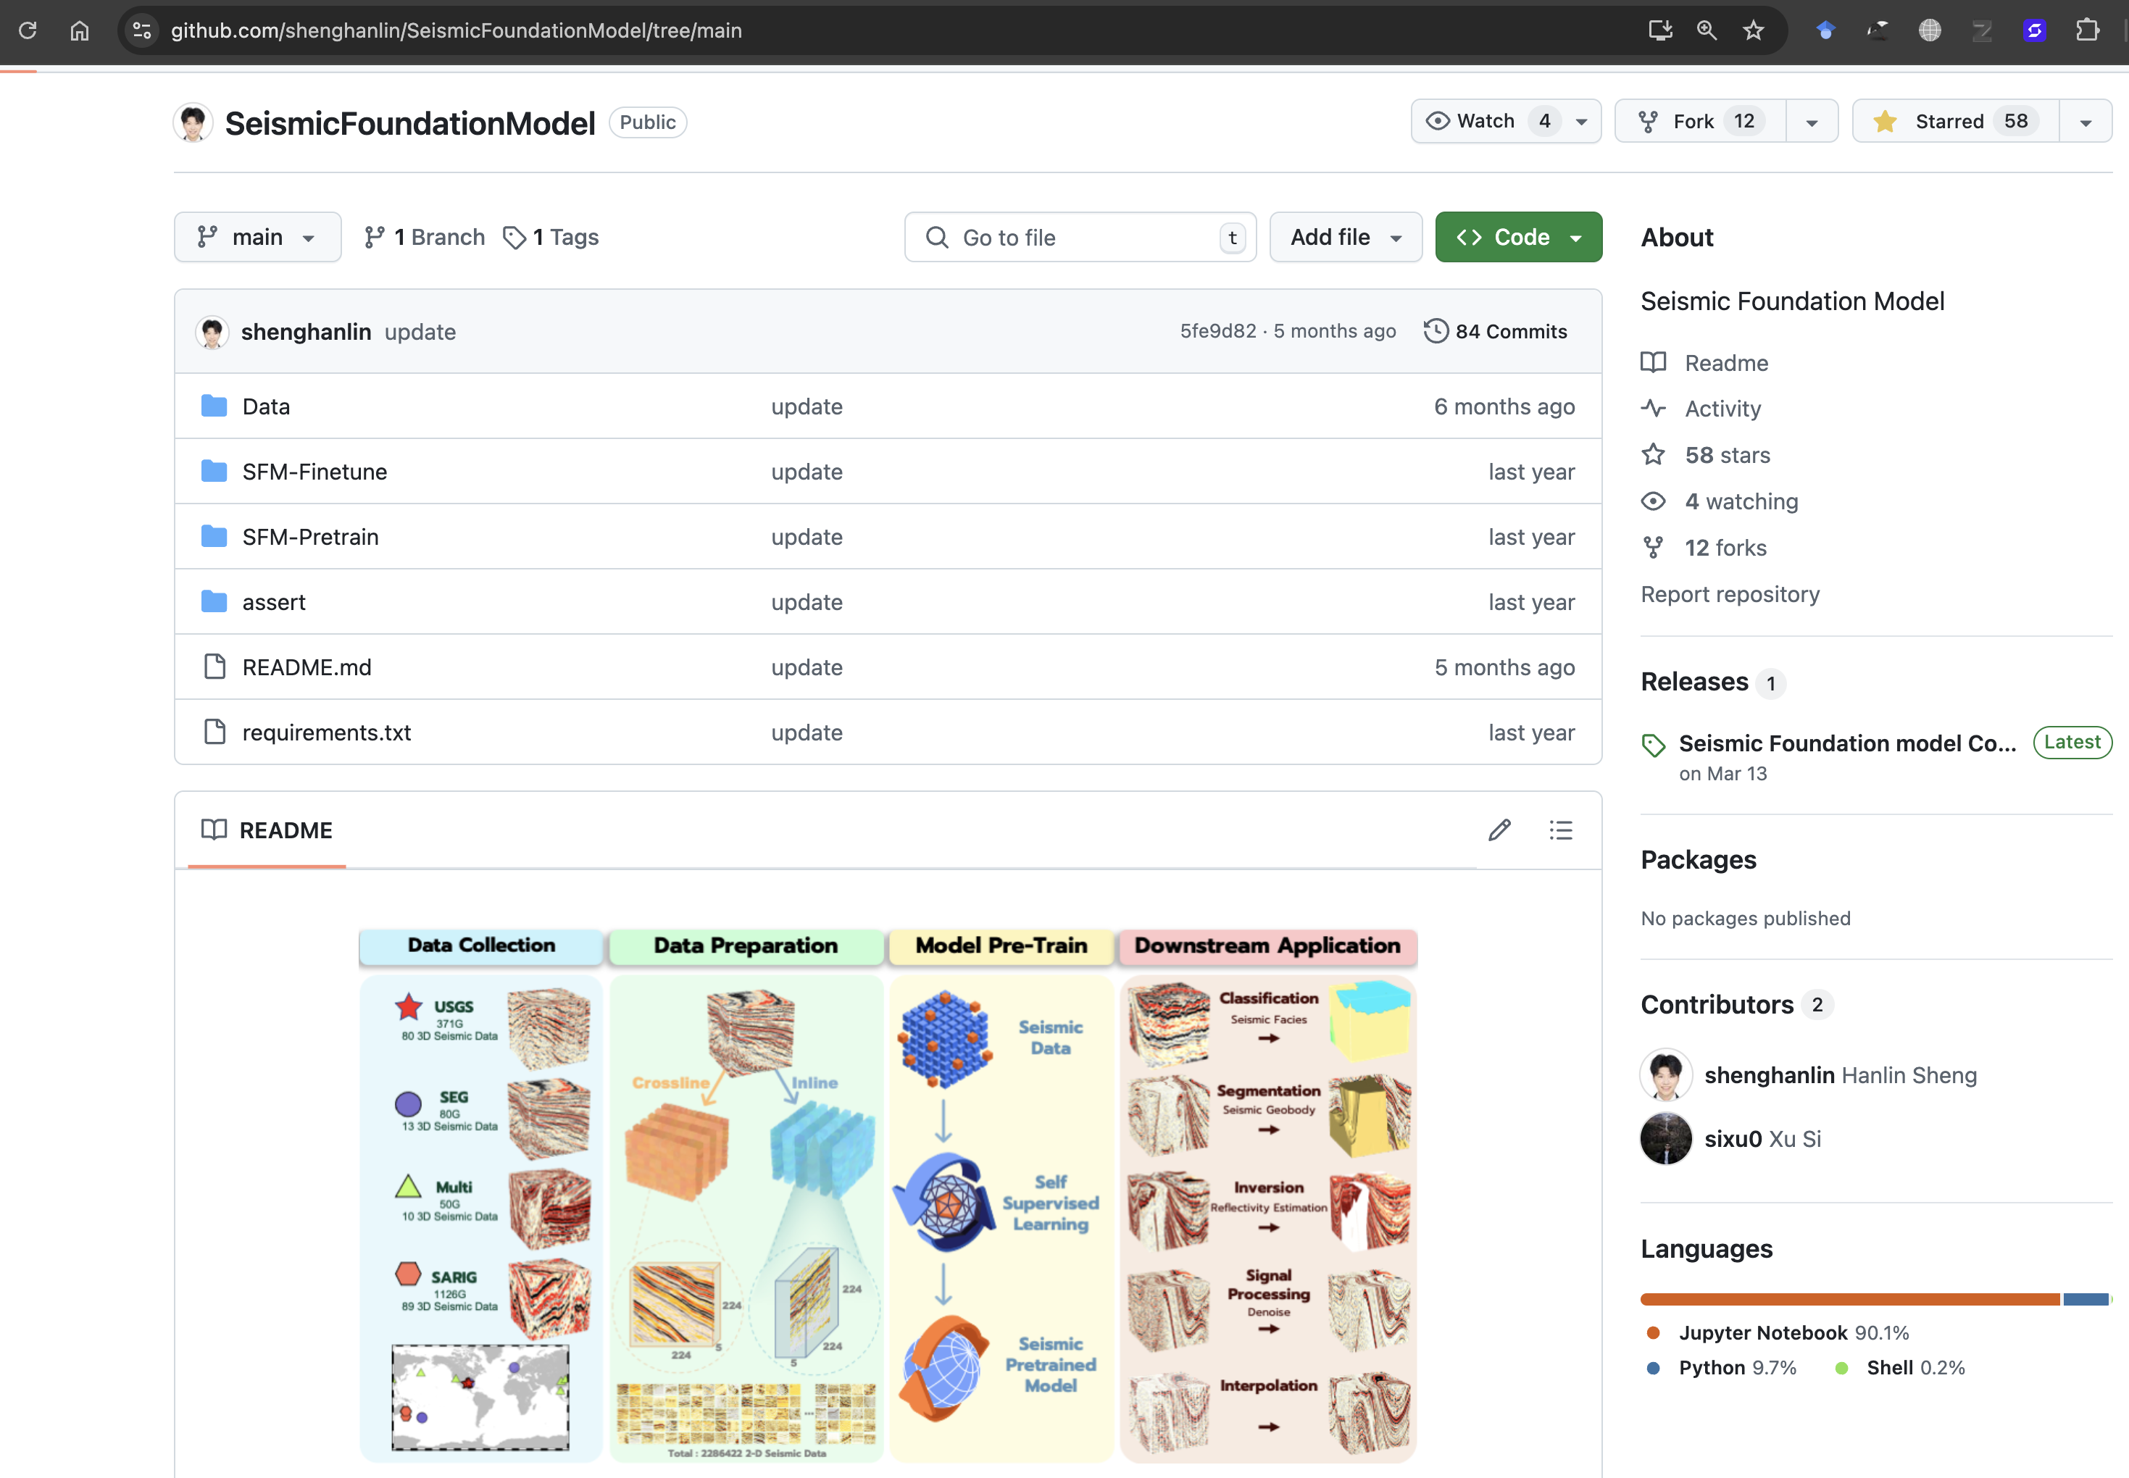
https://github.com/shenghanlin/SeismicFoundationModel/tree/main

Slide 44
Judging Instructions and Criteria
Collectively as a group you will select a winner. These are the critera:
Relevancy to the theme of “seismic embeddings” (Did the presentation demonstrate the team’s ambition to understand the potential of embeddings? Did they use a benchmark or baseline (time, lines of code, number of computers..etc?)
Understandable, with good explanation of the challenge and the solution direction (meaning that the problem and solution were communicated for a more general audience)
Presentation skills and presentation quality (was there a demo? was the presentation engaging and flowed properly?)
*As a last point - note that some teams might not get to a working solution - do not judge them on this - but instead on the effort and ideas on approaching the challenge (what did they try, why did it fail, what would they do different?)

Slide 45
Final Presentation Guide
Each team will have 10 minutes for presentation and 10 minutes for Q&A from the judges and/or facilitators.
Your presentation can be slides/demos/mix – your choice! (But always bonus points for live demos!)
Make sure your final presentation (if slides) is also uploaded(fork and pull) https://github.com/ovcharenkoo/eage_hpc_hackathon_2024
You will present from your own computer.
Recommended that everyone on the team gets a chance to present something ☺

Slide 46
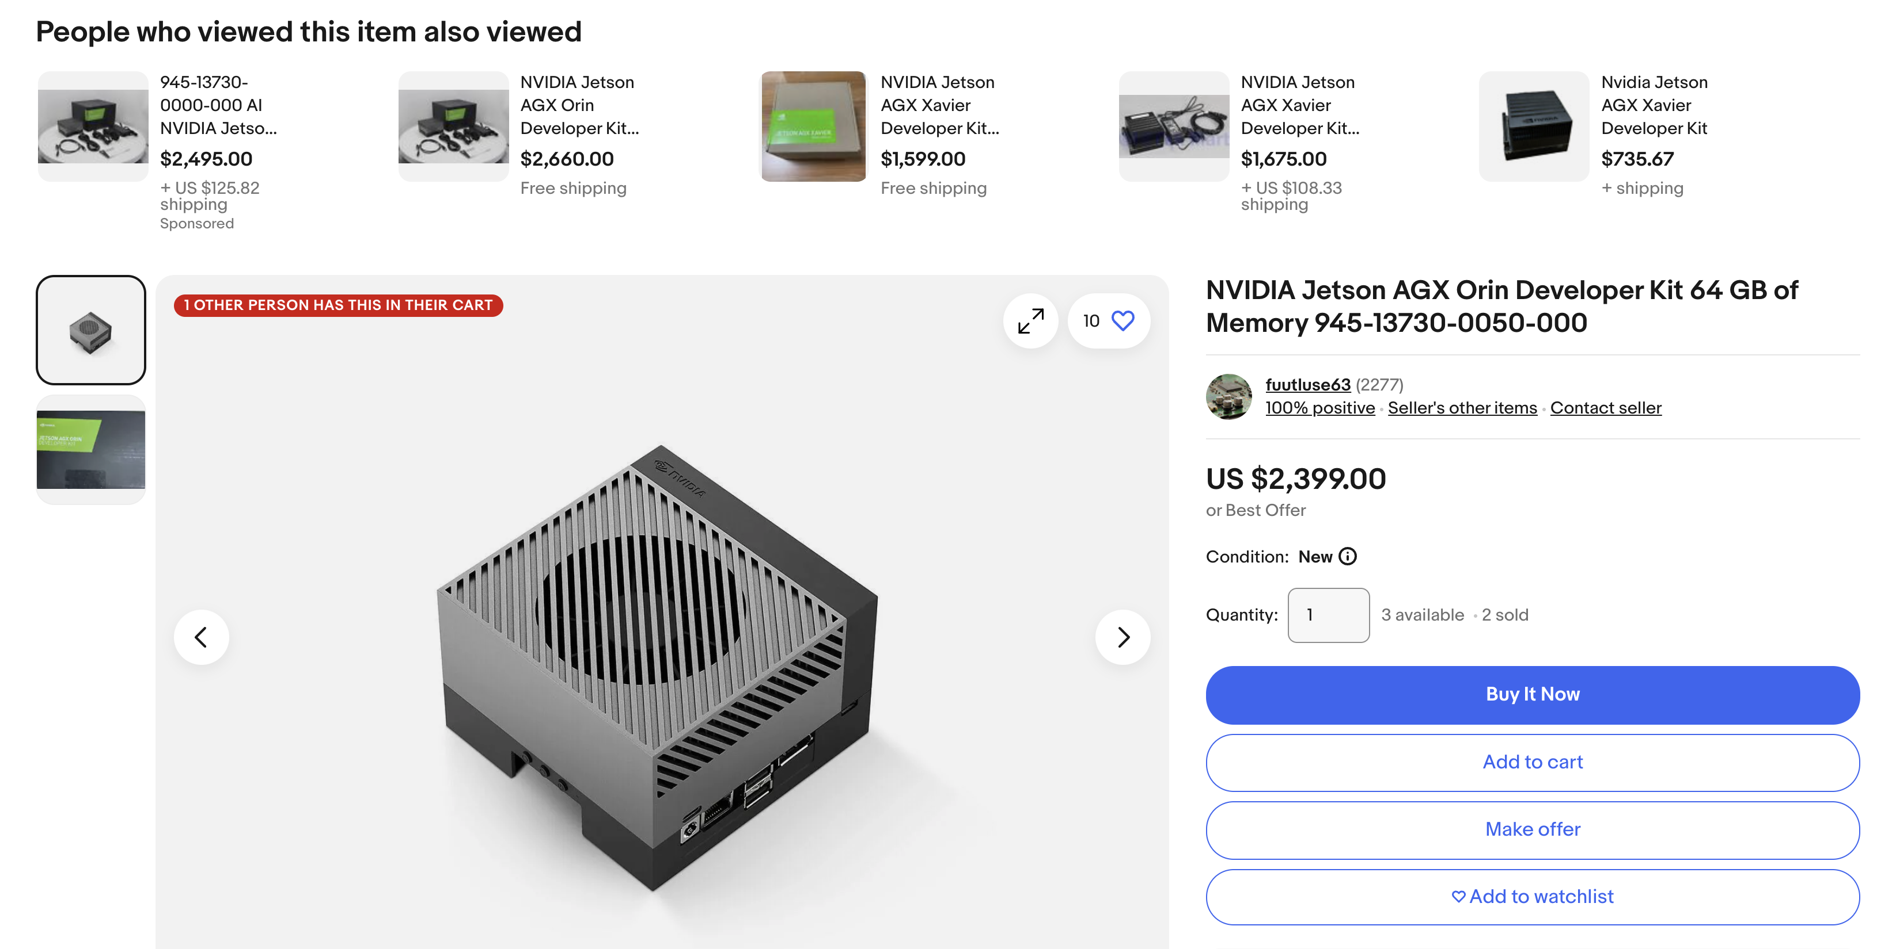
Award!

Slide 47
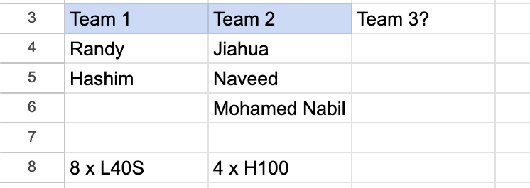
Teams and projects
Team | Members | Project
Team 1 | Hashim Taufik Randy Harsuko | CLIP embeddings with BERT / ViT + TSNe analysis
Team 2 | Naveed Akram Jiahua Zhao | MAE / Hiera for embeddings + TSNe analysis
Team 3

Slide 48
Final Presentation
EAGE HPC Workshop Hackathon 2024
Embeddings for Pre-Stack Seismic Data
15 September, 2024

Slide 49
Exploration geophyscis

Slide 50
How it is realted to HPC?
Imaging

Slide 51
Solution: Explore embeddings for seismic data
Problem: Large amounts of seismic data
> Compress / decompress / reconstruct
> What value we could extract from deep embeddings?
Land and marine cluster separately
Synthetic and real cluster separately
Can you ask data where the first arrival was?
Analogies with video analytics?

Slide 52
Teams and projects
Team | Members | Project
Team A | Hashim Taufik Randy Harsuko | CLIP embeddings with BERT / ViT + TSNe analysis
Team B | Jiahua Zhao Naveed Akram | MAE for real-data embeddings + TSNe analysis

Slide 53
Award!

Slide 54
Judging Panel
Seismic + HPC + AI Experts
Please introduce yourself

Slide 55
Judging Panel
Let the Final Presentations begin!
Each team has 15 min + 5 min QA
Winners will be announced at the Ice Breaker
Codes available at https://github.com/ovcharenkoo/eage_hpc_hackathon_2024

Slide 56
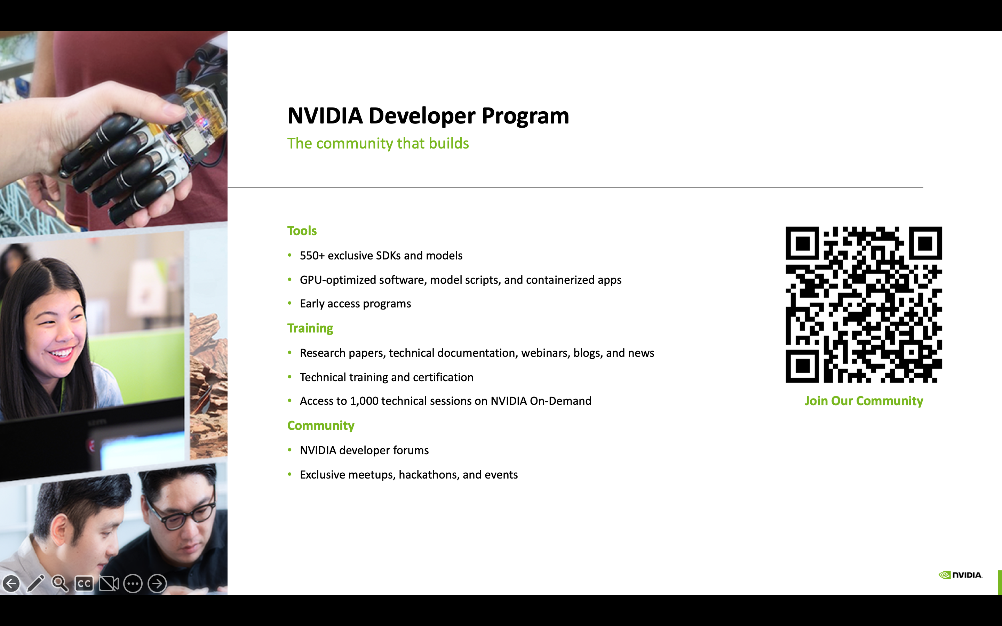

Slide 57
